Slide 1

Comparison of hybrid ensemble/4D-Var and 4D-Var within the NAVDAS-AR data assimilation framework
Presenter: David Kuhl (NRL, Washington DC)
Thomas E. Rosmond (SAIC, Forks, Washington)
Craig H. Bishop (NRL, Monterey, CA)
Justin McLay (NRL, Monterey, CA)
Nancy L. Baker (NRL, Monterey, CA)
Elizabeth Satterfield (NRL, Monterey, CA)

Slide 2
Overview
This talk covers the effect on weather forecast performance of incorporating ensemble covariances into the initial covariance model of the 4D-Var DA system NAVDAS-AR (Naval Research Laboratory Atmospheric Variational Data Assimilation System-Accelerated Representer)
  This hybrid DA system is also called “Ens4DVar hybrid” or “hybrid 4D-Var”
Results show that the hybrid DA scheme significantly reduces the forecast error across a wide range of variables and regions.
This system should transition to operations in 2015 for the Navy’s global NWP system
D. D. Kuhl, T. E. Rosmond, C. H. Bishop, J. McLay and N. L. Baker, “Comparison of hybrid ensemble/4D-Var and 4D-Var within the NAVDAS-AR data assimilation framework,” Monthly Weather Review, 141 (2013) 2740-2758.

Slide 3
Prospective Operational Setup
The hybrid ensemble/4D-Var data assimilation system we have developed is designed to be a component of the existing operational NAVDAS-AR (4D-Var) data assimilation system (Rosmond and Xu 2006, Xu et al. 2005)
The operational ensemble forecasting system (McLay et al., 2008 and 2010) where ensemble members are generated with a local formulation of Bishop and Toth’s (1999) Ensemble Transform (ET) technique and features a short term cycling (6-hour) ensemble of 80 members

Slide 4
Formulation
Analysis State:
Background Error Covariance:
Hybrid Background Error Covariance:
Static Background Error Covariance:
Flow Dependent Background Error Covariance:
Notes:
Partitioned with the D as the background error variances and C as the background error covariances. This was originally formulated for the NAVDAS 3D-Var system with the geopotential and temperature in exact hydrostatic balance and the wind and geopotential variances approximately geostrohpically coupled in the extratropics to uncoupled in the tropics. The correlations are specified to be a function of the distance between points and the interactions between velocity potential, streamfunction, hydrostatic and geostrophic balances. RH field are assumed to be univariate.

Slide 5
Experimental Setup
The resolution for the control forecast model and outer loop of NAVDAS-AR
  T319/L42 (960x480 Gaussian grid with 42 levels in the vertical)
The inner loop resolution of NAVDAS-AR and the ensemble member resolution
  T119/L42 (360x180 Gaussian grid with 42 levels in the vertical)
Two series of experiments assimilated the suite of observations available for the operational data assimilation system, including retrievals and radiances (~1.7 million every 6 hours)
We used a 6 hour data assimilation cycle for both experiments
  The first experiment (boreal summer) extended from 0000 UTC 1 June 2010 until 0000 UTC 1 September 2010
  The second experiment (boreal winter) extended from 0000 UTC 1 January 2011 until 0000 UTC 1 April 2011
  Both Experiments first 30 days thrown out for bias correction and ensemble spin-up
Each series of experiments included three different alpha values: 0 (static mode), 0.5 (hybrid mode) and 1 (flow-dependent mode)

Slide 6
Experimental Setup
80 member Ensemble Generation: Ensemble Transform
Localization: Non-adaptive
  Localization is in physical space and the correlation functions are a function of horizontal and vertical position
  Vertical localization has a shorter vertical scale in the stratosphere than in the troposphere
  Horizontal localization at 50% is approximately 2000km or 20 degrees
Bias Correction: Variational radiance Bias Correction system
  Var-BC two-predictor bias correction approach of Harris and Kelly (2001)
Current Analysis
Ensemble Transform (ET)
Create Analysis Ensemble:
Current analysis is the mean state
Analysis ensemble perturbations are a combination of variances and ensemble perturbations
Estimate of Climatological Analysis Error Variances
Analysis
Ensemble
6-hour Forecast
Ensemble Perturbations
Notes:
ET: transforms the 6-hour forecast perturbations into analysis perturbations such that i) each analysis perturbation is a linear combination of forecast perturbations and ii) the covariance of the analysis perturbations is, on a regionally averaged basis, consistent with the estimate of the analysis error covariance.
The climatological analysis error variance is diurnally varying with values computed at 0, 6, 12, and 18 hours.

Slide 7
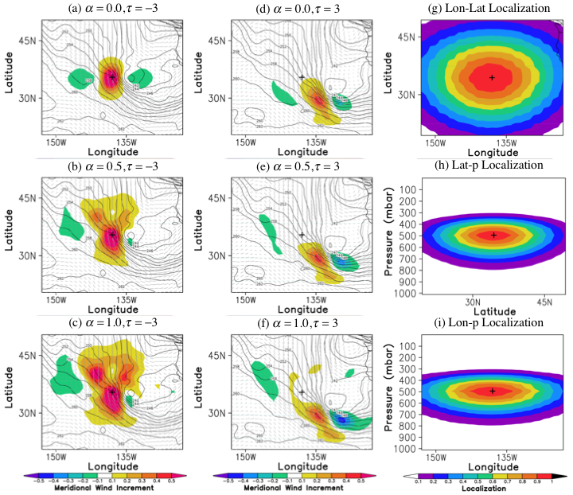
Single Ob. Meridional Wind Response
Static Mode
Alpha=0.0
Hybrid Mode
Alpha=0.5
Flow-dependent Mode
Alpha=1.0
Notes:
Shown are the meridional wind analysis increment fields from assimilating a single meridional wind observation of 1m/s.
Note that at the end of the window all plots show a tilted hourglass shape, but only Hybrid and Flow modes show this shape at the beginning of the window.

Slide 8
Experiments
Alpha=0 Static Mode: Control Experiment
  Essentially the same as the operational 4D-Var system
Boral Summer (July-August 2010)
  0000 UTC 1 July to 0000 UTC 1 September 2010
Boral Winter (February-March 2011)
  0000 UTC 1 February to 0000 UTC 1 April 2011
Five-day forecast launched from 0000 and 1200 analysis each day
Three Regions: NH=20N to 80N, TR= 20N to 20S, and SH=20S to 80S

Slide 9
Vector Wind Results: Static vs. Hybrid Mode
Summer (Jul-Aug 2010) Hybrid Mode
Self-Analysis Verification
Self Analysis used to compute the Vector Wind RMS error
  Red: Hybrid Mode is better
  Blue: Static Mode is better
Columns: Northern Hem., Tropics and Southern Hem.
Top Plots: Impact versus control
  positive impact red for Hybrid, negative impact blue for Static
  y-axis: Pressure Scale: 1000mb to 10mb
  x-axis: Forecast Lead Time 2-5 days
  +/-3 % Scale
Bottom Plots: Statistical Significance
  y-axis: Pressure Scale: 1000mb to 30mb
  x-axis: Forecast Lead Time 2-5 days
  lowest color is 95% Statistical Significance
Notes:
Variable: Vector Wind
Time Period: Jul to Aug 2010
x-axis: Forecast Lead Time 2-5 days
0-2 days are removed since self analysis verification favors smaller impacts from the observations
In fact if no observations were assimilated that would give a perfect self analysis verification
This is mitigated by looking at longer forecast times.
+/-3 % Scale
Black Boxes are the Navy Score card—talk about later
Mostly Red showing that there is an impact of more the 1% to

Slide 10
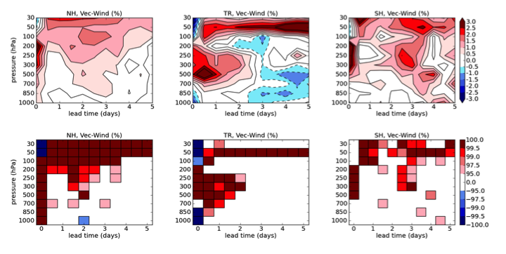
Vector Wind Results: Static vs. Hybrid Mode
Summer (Jul-Aug 2010) Hybrid Mode
Self-Analysis Verification
Radiosonde Verification
Top Plots: Impact versus control
  positive impact red for Hybrid, negative impact blue for static
  y-axis: Pressure Scale: 1000mb to 30mb
  x-axis: Forecast Lead Time 0-5 days
  +/-3 % Scale
Bottom Plots: Statistical Significance
  y-axis: Pressure Scale: 1000mb to 30mb
  x-axis: Forecast Lead Time 0-5 days
  lowest color is 95% Statistical Significance
Notes:
Verification: Radiosonde observations used to compute the Vector Wind RMS error
Note that in some regions the the Static mode does better but it is not statistically significant
Note also that some regions the static analysis is closer to the radiosondes but then all subsequent forecasts the hybrid mode is better.
This suggests that the hybrid mode analysis were better than the static analysis. This is possible since observations are themselves are imperfect
(aside if needed: Note also the magnitudes of the improvements for the Self Analysis is larger than for the Radiosondes—we don’t know but not that the analysis and radiosonde errors are inherently different and this could just be a result of that.)

Slide 11
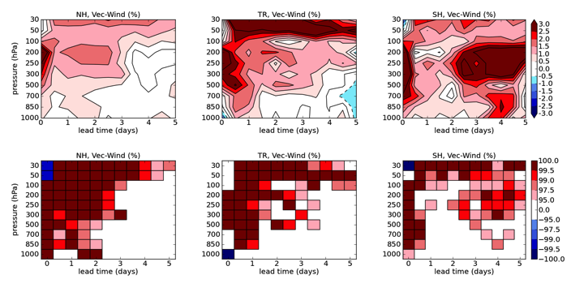
Vector Wind Results: Static vs. Hybrid Mode
Summer (Jul-Aug 2010) Hybrid Mode
Self-Analysis Verification
Radiosonde Verification
Winter (Feb-Mar 2011) Hybrid Mode
Self-Analysis Verification
Radiosonde Verification
Notes:
Finally we add in the results from the Boral Winter –these figures are very similar to the Summer results in many areas. Thus this system seems to work for different times of the year.

Slide 12
Vector Wind Results: Static vs. Flow Mode
Summer (Jul-Aug 2010) Flow Mode
Self-Analysis Verification
Self Analysis used to compute the Vector Wind RMS error
  Red: Flow Mode is better
  Blue: Static Mode is better
Columns: Northern Hem., Tropics and Southern Hem.
Top Plots: Impact versus control
  positive impact red for Flow, negative impact blue for Static
  y-axis: Pressure Scale: 1000mb to 10mb
  x-axis: Forecast Lead Time 2-5 days
  +/-12 % Scale
Bottom Plots: Statistical Significance
  y-axis: Pressure Scale: 1000mb to 30mb
  x-axis: Forecast Lead Time 2-5 days
  lowest color is 95% Statistical Significance
Notes:
Variable: Vector Wind Static vs. Flow Mode
Above 100mb agrees well with Hybrid Mode results and in fact the Flow-dependent results are even stronger.
Below 100mb it is clear that the Static Mode (and thus the Hybrid Mode) results are better in the extra tropics.

Slide 13
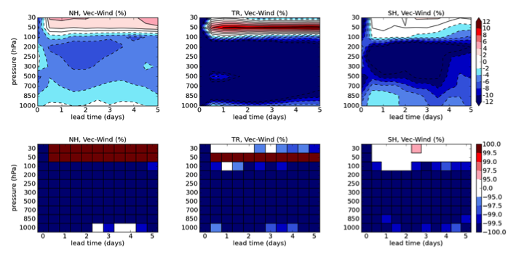
Vector Wind Results: Static vs. Flow Mode
Summer (Jul-Aug 2010) Flow Mode
Self-Analysis Verification
Radiosonde Verification
These results, that the Flow-dependent mode case is worse than the static mode, are contrary to what Buehner et 2010 found.
  This suggests that the ratio of the accuracy of the Canadian ensemble covariance model to the static covariance model is greater than the corresponding ratio for our system
  Differences between our setup and Canadians:
    The Canadian ensemble incorporates samples from a static covariance (Houtekamer et al. 2005) Thus suggesting that their system may not benefit as much from being linearly combined with a static covariance model.
    Canadian 96 members vs. 80 members
    Canadian EnKF likely is a more accurate estimate of the analysis error covariance than the ET
    Finally Buehner et al. simulate the effect of model error in their system
Notes:
Again showing the verification versus radiosondes as before.
Again note that above 100mb we see results similar to the Hybrid mode.
But now below 100mb again the static (and hybrid) is better in the extra tropics but the radiosondes are telling us static is also better in the tropics.
In a case like this an independent set of data is necessary to determine the correct.
These results, that the Flow-dependent mode case is worse than the static mode, are contrary to what Buehner et 2010 found.
This suggests that the ratio of the accuracy of the Canadian ensemble covariance model to the static covariance model is greater than the corresponding
One significant difference between our ensemble and the Canadian ensemble is that the Canadian ensemble incorporates samples from a static covariance (Houtekamer et al. 2005)
Thus suggesting that their system may not benefit as much from being linearly combined with a static covariance model.
There are aother differences as well, 96 members vs. 80 members
EnKF likely provides a more accurate estimate of the analysis error covariance than the ET
Finally Buehner et al. simulate the effect of model error in their system

Slide 14
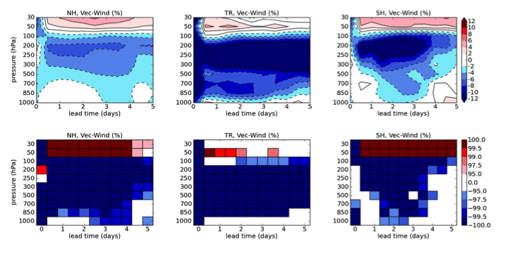
Vector Wind Results: Static vs. Flow Mode
Summer (Jul-Aug 2010) Flow Mode
Self-Analysis Verification
Radiosonde Verification
Winter (Feb-Mar 2011) Flow Mode
Self-Analysis Verification
Radiosonde Verification
Notes:
Finally we show again that the Winter results are similar to the summer results.

Slide 15
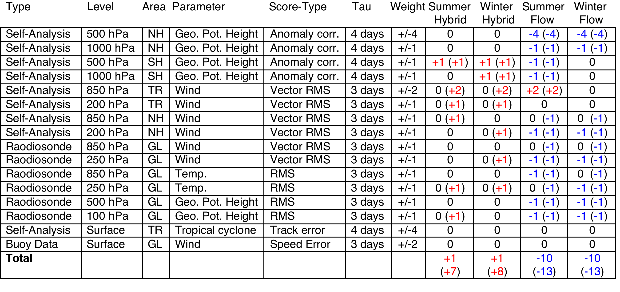
Score Card Results
The Score card is an aggregate tool used by the U.S. Navy operational center (FNMOC) to summarize verification results compared against a control—in our case the static mode.
Notes:
The score cards are particular points on the plots that I had been showing, Some of these I had marked with a black square around them. Like Self-Analysis, 850 hPa, TR, Wind Vector RMS, tau=3 days. Some have greater weights like 500 hPa GPH Anomaly correlation: 4points. Except for the Anomaly correlations an impact of greater than 5% is needed along with statistical significance. I have provided the results if the impact is less than 5% but it is still statistcially significant with the parethese. This 5% need was probably worked in because the statistical significance used to not be computed properly, i.e. not adjusting for temporal correlations. The score card results for NAVDAS (3D-Var) were +1 and the score card for NAVDAS-AR (4D-Var) were +4.
For example, the flow-dependent mode experiment had greater than a 30% reduction in the tropical vector wind RMS errors against self-analysis for all forecast lead times (Figures 13 and 14) for all levels 100 hPa and above. In contrast, the hybrid mode experiment (Figures 5 and 6) had between 5 and 20% improvement for most of those levels and forecast lead times. For this reason, we hypothesize that a spatially varying value of may yield the best results.

Slide 16
Conclusions
Our results show that the hybrid mode (α=0.5) data assimilation scheme significantly reduces forecast error across a wide range of variables and regions compared to the static mode (α=0) system.
The improvements were particularly pronounced for tropical winds.
In the verification against radiosondes, the hybrid mode was statistically significantly better than the static mode with a greater than a 0.5% reduction in RMS vector wind error differences.
In the verification against self-analysis we showed a greater than 1% reduction from verifying against analyses between 2 and 5 day lead time at all 8 vertical levels examined in areas of statistical significance.
In contrast to Buehner et al. (2009 b), we found that using only the flow-dependent ensemble (α=1) led to an overall degradation in data assimilation performance for our system.
  We speculate that improvements to our ensemble generation scheme, increasing in the number of ensemble members and improvements to our localization scheme would improve the relative performance of this flow-dependent case.

Slide 17
Current Work
Setting system up for new semi-lagrangian model
Repeating tests with new model
Improvements of:
  Localization
  Ensemble Generation
  Computation of Alpha, spatially varrying
Operational Implementation 2015

